Slide 1


Welcome Back to Mr. Ulcena’s Classroom
Tuesday, January 05, 2023

Slide 2

Agenda
Virtual Handshake
Classroom norms
Tell me something good!
Location of weekly Agenda

Slide 3
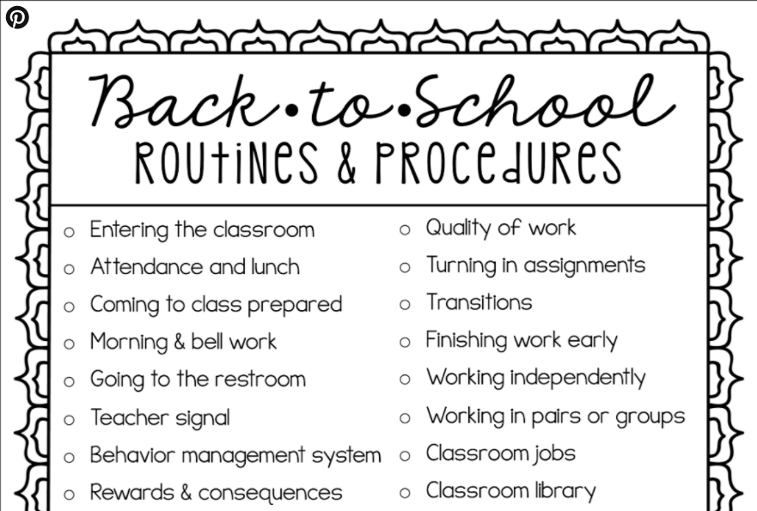

Slide 4
Why do we have policies?
A policy is a plan that guides our actions.
To do things effectively, we have to adhere to some common sense policies:
  Governments invoke laws to help maintain peaceful communities.
  Companies have by-laws in order to facilitate productive work environments.
  Games have rules to create a baseline standard of play.
        So, to be successful in learning, you need to follow some basic classroom rules! I call them my class policies.

Slide 5
Classroom Policies
Be ready to learn.
Always act and speak in an appropriate manner.
No food, or drink allowed.* (Without Teacher’s permission)
No personal electronics allowed. (Without Teacher’s permission)
Respect the classroom environment.
    *Water and medical necessity are
    the ONLY exceptions*

Slide 6
Possible Behavioral Consequences
Warning
Conference with student
You call home and explain to parents
I make formal parent contact
Morning school detention
Referral to Administration

Slide 7
Why Do We Have Procedures?
A procedure is the way that we do things.
To do things efficiently, we have to follow some simple procedures, for example:
  To open your locker, you have to select your combination as directed by the lock manufacturer.
  To cook a delicious meal, you need to follow the steps in the recipe.
  To place a call on your phone, you need to dial the number in the right order.
        So, to be successful in learning, you need to follow some simple procedures!

Slide 8
ENTRANCE
Make sure you have all necessary materials for the class.
Enter the classroom quietly.
Pick up any handouts and do any housekeeping items quickly and quietly.
Go directly to your assigned seat.
Get ready for work.
Start on the “Do Now”

Slide 9
During Instruction
Listen to the teacher/speaker with full attention.
No pencil sharpening, talking, moving about the classroom, or whispering.
Ask permission to speak by raising your hand and waiting quietly to be called on.
After instruction, make sure you understand the concept.
If not, ask questions by mentioning which part you didn’t understand.

Slide 10
If the Teacher Raises His Hand
Stop whatever you are doing at that moment.
Face the teacher and wait silently.
Quietly, notify any classmates who haven’t noticed that the teacher has raised her hand.
No talking or whispering. All of your attention should be given to the teacher.

Slide 11
When You Are Absent
Ask your neighbors what we did.
If you have questions about assignments, check with the teacher at an appropriate time. Do the work at home.
Always check teacher’s website for weekly WAG (week at a glance)
If you missed a test because of an excused absence, inform the teacher and arrange a time to make up the test after school.
        You will have one day to make-up work for every day you are absent.

Slide 12
While You Are Working
Make sure you read or listen to the directions about your work and understand the directions.
If you didn’t understand, quietly ask for help from other students sitting around you.
If you are asked to help, be polite and help.
Talking to each other should be no louder than a whisper.
Respect each other and be friendly.
Use your time wisely. Put forth your best effort to finish your work on time.

Slide 13
After You Are Finished
Check your work and the directions one more time to see if you missed anything or did something incorrectly.
Check to see if the heading is written correctly on your paper.
If the assignment is to be turned in, do so.
If appropriate, read quietly in your seat.

Slide 14
Maintaining the Classroom
Pick up any garbage around you.
Do not intentionally deface school, personal, or other’s personal property.

Slide 15
Dismissal
Clean your work area and take all garbage to the trash can.
Wait in your seat for the teacher to dismiss you.
Leave quietly, ONLY after you have been given permission to do so.

Slide 16
When You Have an Excused Tardy
Report to attendance office to get tardy slip.
Enter the classroom quietly and go to your seat.
You will not be excused from any work you missed. Quietly, get the assignment and do the work at home.

Slide 17
More Attendance Procedures
Unexcused absences do not need to go through the attendance office. Just come straight to class.
If you are 10 minutes (or more) late, you will be marked absent!
        If this absence will be excused, go to the attendance office to get your excuse note.

Slide 18
When There Is a Substitute
We treat guests in our room as courteously or better than we treat Mr. Ulcena.
  Sit in your assigned seat ONLY.
  Maintain proper voice levels.
  Remain on task.
  Be helpful and courteous.
        Subs will report behaviors (good & bad) and proper consequences will be applied.

Slide 19

Tell me something good!!

Slide 20
Final Thought
Location of assignments
Restroom
Skipping class
Fighting
Technology

Slide 21
“Learning without reasoning leads to confusion; thinking without learning is wasted effort.”
~Confucius

